Slide 1
Week 6
Introduction to EER Diagrams – Enhanced Entity-Relationship Diagrams

Slide 2
Student Objectives
Upon completion of this video, you should be able to:
Determine when an entity type could be further categorized as a set of subclasses and what their superclass would look like and represent this in an EER diagram
Determine when several entity types could be grouped together and generalized to form a superclass and represent this in an EER diagram
Determine if the subclasses overlap or are disjoint and represent this in an EER diagram
Determine if the instances of superclass must have partial or total participation with the subclasses and represent this in an EER diagram

Slide 3
Entities as Objects
If we think of entities as objects, then the entity type is an object class.
Eg. Entity STUDENT in an ER Diagram could also be the class STUDENT in Java.
Then we can introduce subclasses (subtypes) to enhance our data modeling.
Just as with OO programming, subclasses inherit properties from their superclass
In the database case, they inherit all the attributes and relationships.
NOTE: an entity cannot exist in the database by JUST being a member of the subclass, it must also be a member of the superclass.
The Enhanced in Enhanced ER Diagrams (EER Diagrams) means we have ER diagrams with inheritance.

Slide 4
Specialization
Process of finding a set of subclass (subtypes) of an entity.
Each subclass will have some distinguishing characteristics of the superclass
Example: laptop and desktop are subclasses of computer
Remember the ISA rule → Only use this if you can say the subclass IS A superclass.
Example:
Laptop IS A Computer – YES (so laptop can be a subclass of Computer)
Country IS A Continent – NO (so Country should NOT be a subclass of Continent)

Slide 5
Example:
SSN
BDate
The U on the line from Secretary to the d node indicates that the set of all instances of Secretary is a subset of the set of instances of Employee.
The d in the node indicates that these three subsets (Secretary, Technician and Engineer) are disjoint
Name
Address
Employee
d
TypingSpeed
Tgrade
EngType
Technician
Engineer
Secretary

Slide 6
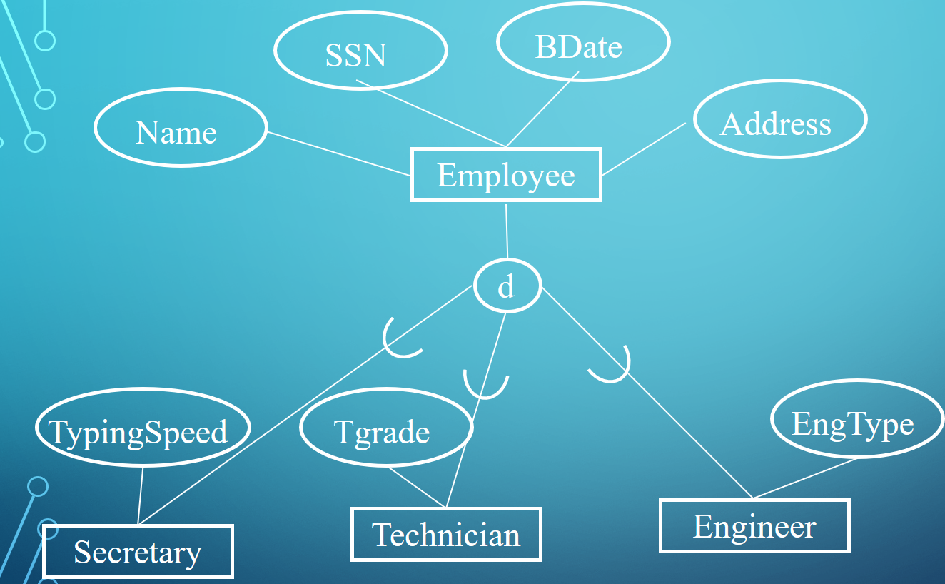
Example
Secretary
This shows a few instances and we can see partial participation in the inheritance, i.e. only some employees belong to one of the subclasses (e.g. e5 doesn’t).
Indicate partial with a single line
e1
e3
Employee
e1
e2
e3
e4
e5
e6
…
Technician
e4
Engineer
e2
e6

Slide 7
SSN
BDate
Name
Address
Employee
If all Employees must belong to a subclass, then it is called total, and is indicated by a double line
d
Salary
PayScale
HourlyEmployee
SalariedEmployee

Slide 8
Generalization
The opposite of Specialization is Generalization
Identify common features and generalized them into a single superclass.
Example: Suppose you are modeling vehicles:
VehicleID
NoOfPassengers
Price
Price
VehicleID
Car
Truck
NoOfAxels
LicensePlateNo
LicensePlateNo

Slide 9
And you realize that it makes sense to have a superclass containing the common attributes:
Price
VehicleID
LicensePlateNo
Vehicle
d
NoOfAxels
NoOfPassengers
Truck
Car

Slide 10
Sometimes the instances of the subclasses overlap – indicated with an o in the circle
Example:
Person
o
Employee
Alumnus
Student

Slide 11
Can use a category to indicate which subclass an instance belongs to
Example:
SSN
BDate
Name
Address
Employee
JobType
JobType
d
“secretary”
“engineer”
TypingSpeed
EngType
Tgrade
“technician”
Engineer
Secretary
Technician
In this case, a trigger could insert a new employee into the appropriate subclass based on the value of JobType.

Slide 12
Notes
Help to make the conceptual model more accurate (but can cause clutter)
If subclass has few attributes and no relationships, might want to merge into superclass (specific attributes would be null for entities not a member of the subclass)
The default for disjoint/overlapping and total/partial is overlapped/partial (only put disjoint and/or total if it makes sense)

Slide 13
Question
Consider the following entity sets and attributes. Place a checkmark ✔in ONE column in each row to indicate the relationship.
Entity Set | Has a relationship with | Has an attribute that is | Is a specialization of | Is a generalization of | Entity Set or Attribute
Mother |  |  |  |  | Person
Daughter |  |  |  |  | Mother
Student |  |  |  |  | Person
Student |  |  |  |  | StudentNumber
School |  |  |  |  | Student
Animal |  |  |  |  | Horse
Horse |  |  |  |  | Age
Furniture |  |  |  |  | Chair
✔
✔
✔
✔
✔
✔
✔
✔
Hint: use the “IS A” Rule to help decide!

